Slide 1
Topic 08 Network Applications and Configuration

Slide 2
Contents
TCP/IP and Network Commands
Managing Network Interfaces
Basic IP Routing and Gateways
Address Resolution Protocol (ARP)
Miscellaneous Network Settings
Email Overview

Slide 3
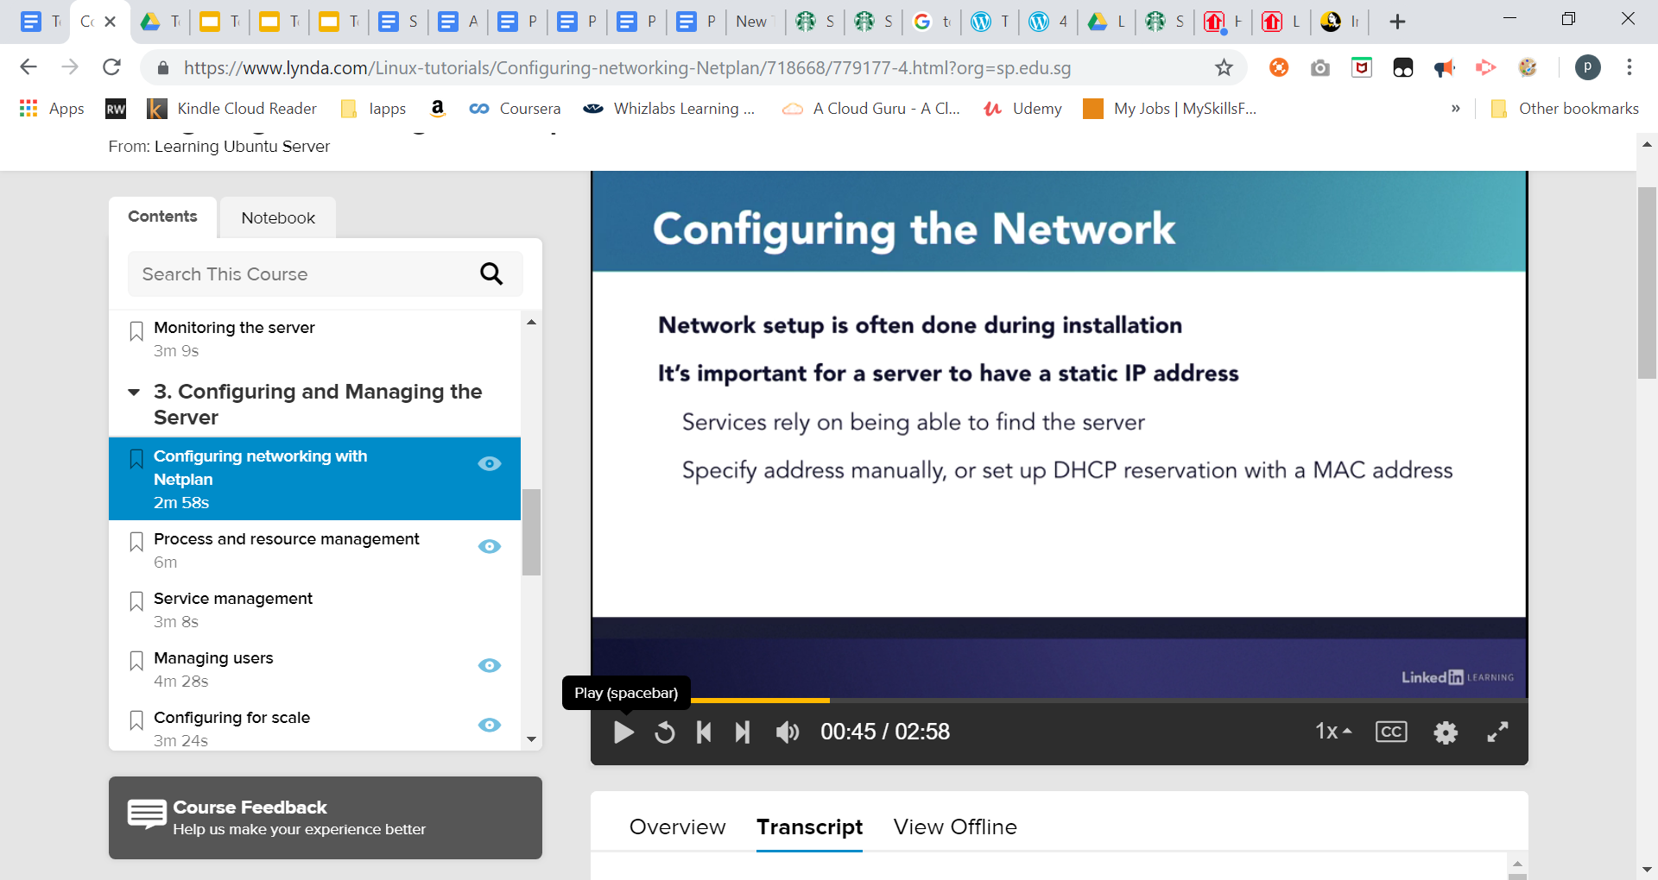
Static IP Address for a Server Why and HOW?
Notes:
when we set up a server we specify the network parameters during set up. Otherwise, we wouldn't be able to download updates, host services, or even connect to it once it's set up. It's important for a server to have a static IP address. We want the IP address of the server to be the same all the time so we can reliably connect to it. And if you're hosting services like DNS, it's critical for the address to stay the same. Otherwise other services and hosts won't be able to find your server. There's two ways of making sure that a server gets the same address time and again.
We can either specify it manually like we did during the set up of this course or we can take the network interfaces MAC address. The hexadecimal number that nearly uniquely identifies a network interface and tell our router or DHCP server to always assign the same address to that interface. Personally, this is how I prefer to set addresses on my network. But on cloud services you don't always have that flexibility. There are also times where we need to change the static address of a server in case the network configuration changes or the server simply needs to be moved.
Starting with version 17.10 Ubuntu uses software called Netplan to manage the network connections. While in earlier versions, we'd make changes to the networking configuration in ETC network interfaces, now we make changes to files in the ETC netplan folder. Depending on your system, the name of the file where we'll set the configurations may be different. Here in my system it's called 50-cloud-init.yaml.
I'll open it up. This file and other files for Netplan and for the broader cloud-init configurationsare written in yaml, which stands for, yet another markup language. If you'd like to learn more about yaml we have videos that describe the structure and syntax. One of the nice things about yaml is that it makes sense if you look at it for a little bit. So, let's dive in. Here at the top level we have network. And inside that ethernets. You can define more than one ethernet interface in this block. That's why it's called ethernets. There's also options for wifi and other media.
My interface name enp0s3, is inside the ethernets block. And that has addresses. In this case, just one. But again, you can set more than one should your set up require it. Gateway4 is the IPV4 default gateway or router. And nameservers are the DNS servers the system will use. I can see that my static address is set here. And if I wanted to I could change it. Sometimes, servers need additional network interfaces like when they're in a DMZ or for other more advanced configurations.
And those can be defined here as well. I like my set up right now and I don't need to make any changes. If I did, I would save the file and then run netplan apply. I wanted to make sure to point out where the network settings have moved to. If you'd like to explore Netplan more,be sure to check out the man page for it.

Slide 4
TCP/IP and Network Commands
Well known services are listed in /etc/services.
The netstat command is used to display information about open ports.
The ifconfig command is used to display and set the IP addresses of the network cards.
The ip command can also be used to display and set the IP addresses of the network cards.
The hostname command is used to display the machine’s hostname.

Slide 5
Netplan
Netplan is a new command-line network configuration utility introduced in Ubuntu 17.10 to manage and configure network settings easily in Ubuntu systems. It allows you to configure a network interface using YAML abstraction. It works in conjunction with the NetworkManager and systemd-networkd networking daemons

Slide 6
Netplan Configuration file: /etc/netplan/50-cloud-init.yaml
Netplan Configuration Files:
On Ubuntu 18.04 LTS, the Netplan YAML configuration files are placed in the /etc/netplan/directory. To configure a network interface, you have to create or modify required YAML files in this directory. YAML configuration files has the .yaml extension. The default Netplan YAML configuration file /etc/netplan/50-cloud-init.yaml is used to configure network interfaces using Netplan.
Change into that directory with the command cd /etc/netplan. Once in that directory, you will probably only see a single file:
50-cloud-init.yaml
You can create a new file or edit the default. If you opt to edit the default, I suggest making a copy with the command:
sudo cp /etc/netplan/50-cloud-init.yaml
/etc/netplan/50-cloud-init.yaml.bak
With your backup in place, you’re ready to configure.

Slide 7
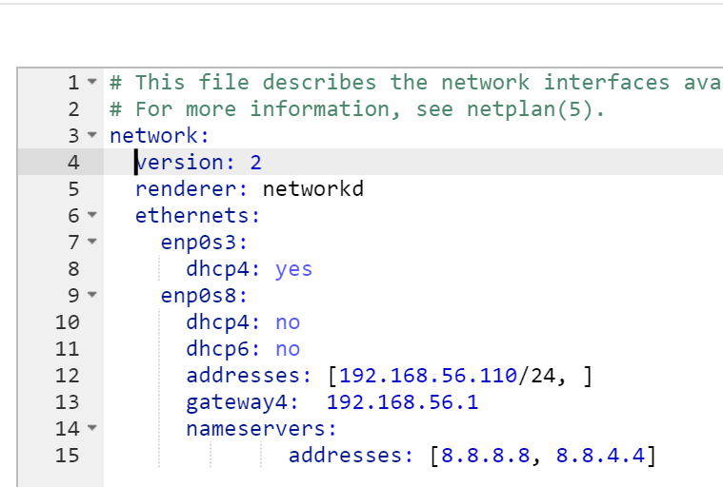
SAMPLE: /etc/netplan/50-cloud-init.yaml
Where:
enp0s8 – network interface name.
dhcp4 and dhcp6 – dhcp properties of an interface for IPv4 and IPv6 receptively.
addresses – sequence of static addresses to the interface.
gateway4 – IPv4 address for default gateway.
nameservers – sequence of IP addresses for nameserver.
https://codebeautify.org/yaml-validator/cb7bd6e7

Slide 8
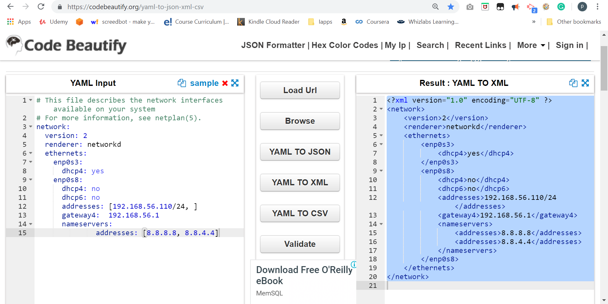
https://codebeautify.org/yaml-to-json-xml-csv/cbf85994

Slide 9
Resolving domain names (DNS)
When you type "www.yahoo.com" in a web browser, the Domain Name System (DNS) will resolve it to the IP address of Yahoo web server.
When resolving hostnames to IP addresses, Linux systems will check the /etc/hosts file first.
If the /etc/hosts file does not contain the hostname, the DNS server will be queried. The DNS server is specified in /etc/resolv.conf.
The host command can be used to perform DNS queries
Notes:
Can use “host www.google.com”

Slide 10
Managing Network Interfaces
The ifconfig command can be used to set the IP address, netmask, etc.
Any setting with the ifconfig command will be lost upon the next reboot.
To make the changes persistent across reboots, edit the config file /etc/netplan/50-cloud-init.yaml
Save the file and exit. Then apply the recent network changes using following netplan command.
$ sudo netplan apply
Now verify all the available network interfaces once more time, t$ ifconfig -a
Notes:
More info on how to configure NetworkManager
https://live.gnome.org/NetworkManager/SystemSettings

Slide 11
TCP/IP and Network Commands
The ping command is used to test network connectivity between hosts. Sometimes the firewall may be blocking the ping command from running successfully.
The ping command is used by traceroute (tracert in Windows) and mtr to find out how the packet have travelled.

Slide 12
Basic IP Routing and Gateways
The route command is used to manage the gateway & display the routing table.
Any setting with the route command will be lost upon the next reboot.
The config file in directory to define a gateway for a particular network interface. /etc/netplan/50-cloud-init.yaml

Slide 13
Address Resolution Protocol (ARP)
In order to communicate with other machines, your system needs to know the hardware addresses (MAC address) of the other machines.
Your system will keep an ARP (Address Resolution Protocol) cache that stores the IP address and MAC address mappings.
The arp -a command is used to display the ARP cache.

Slide 14
Email Overview
For mail to work, need to run sudo apt install mailutils
In Linux, incoming mail is delivered to /var/spool/mail/username.
The mail command is a Mail User Agent (MUA) for reading and creating mails.
Common switches for the mail command:
-v verbose mode
-s subject specifies a subject for the mail
-c addresses send carbon copies to the specified addresses
-b addresses send blind carbon copies to the specified addresses (not supported)
Mails that have been read and saved are moved to ~/mbox.

Slide 15
Summary
TCP/IP and Network Commands
Managing Network Interfaces
Address Resolution Protocol (ARP)
Basic IP Routing and Gateways
Miscellaneous Network Settings
Email Overview Try Practical 11

